Slide 1
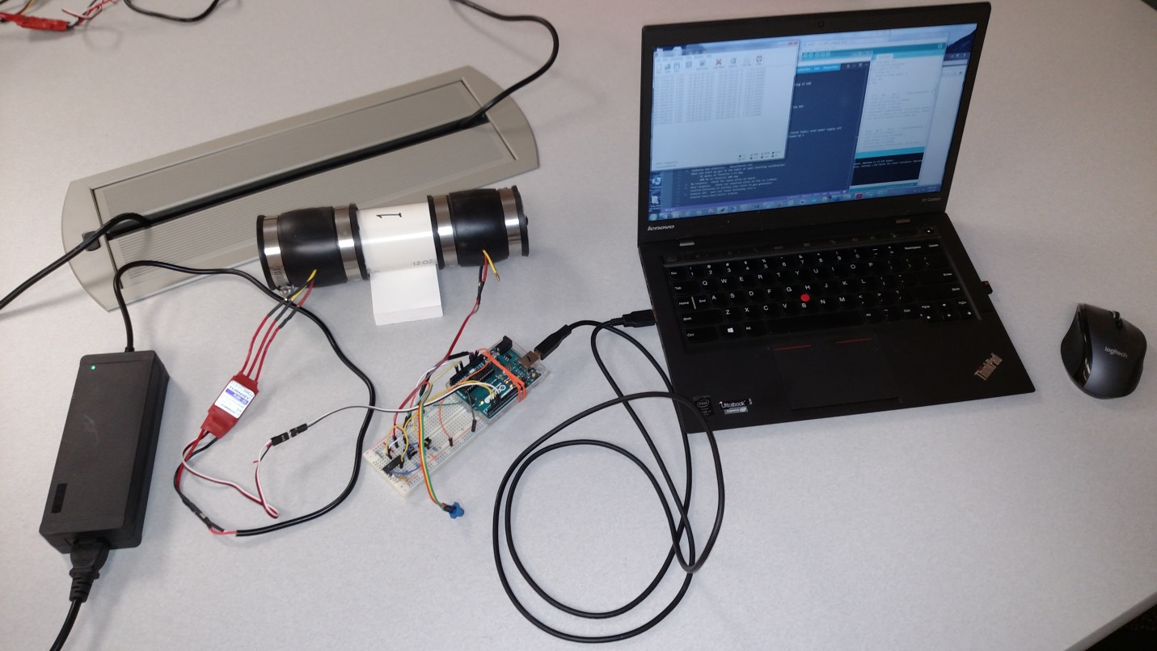
A-Course Controls Assignment “Controlling in the Wind” Setup Instructions
Brendan Higgins/Dave Gutz
January 2017

Slide 2
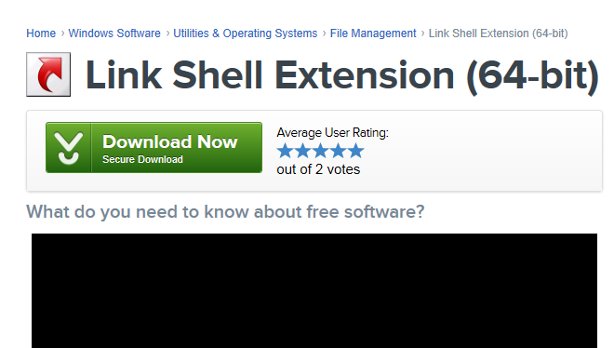
Step 1: Install link shell extension (LSE)
Makes it easy to modify Arduino code
Link to download:
http://download.cnet.com/Link-Shell-Extension-64-bit/3000-2248_4-75213087.html
Link to manual:
http://www.howtogeek.com/howto/16226/complete-guide-to-symbolic-links-symlinks-on-windows-or-linux/
Click here. It will make you restart explorer.

Slide 3
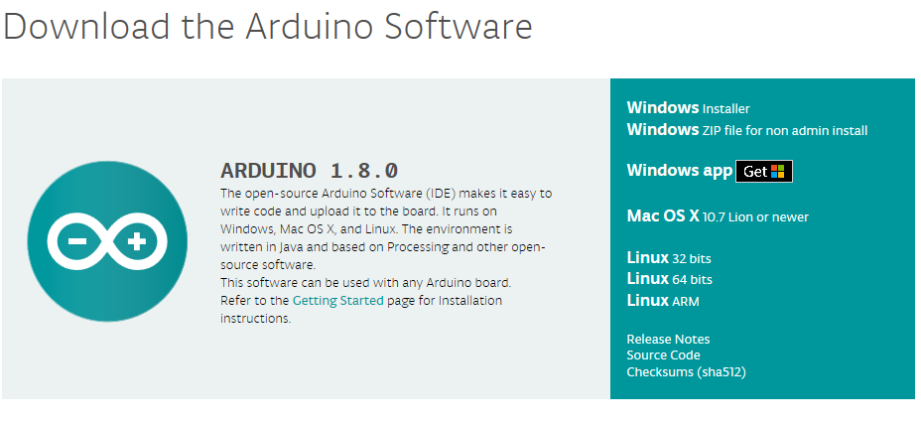
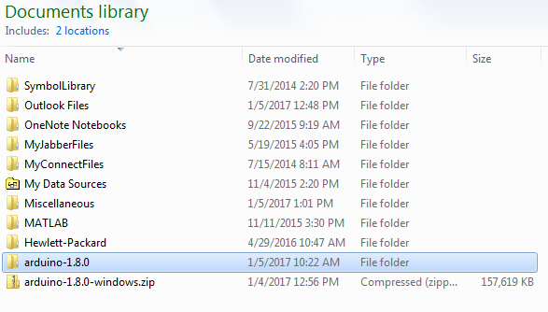
Step 2: Install Arduino
Needed to run microcontroller
Click “Windows ZIP file for non admin install”
Link to download:
https://www.arduino.cc/en/Main/Software
Reference link (should not need this): https://www.arduino.cc/en/Guide/PortableIDE
Download and unzip into “My Documents”:

Slide 4
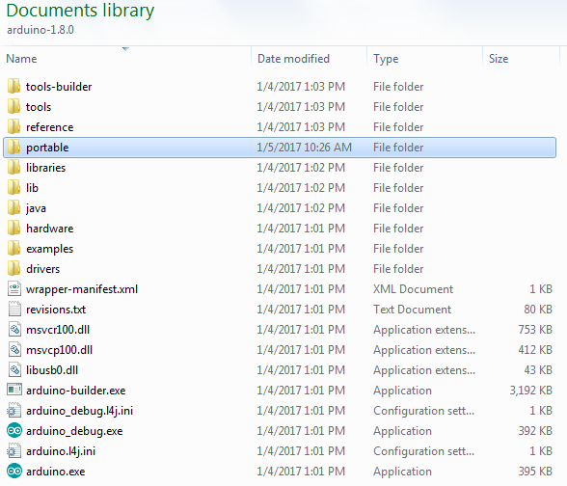
Step 3: Browse to root of arduino-1.x.x
Create new directory called “portable” alongside others

Slide 5
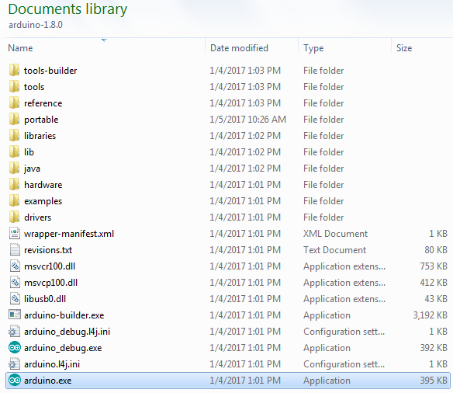
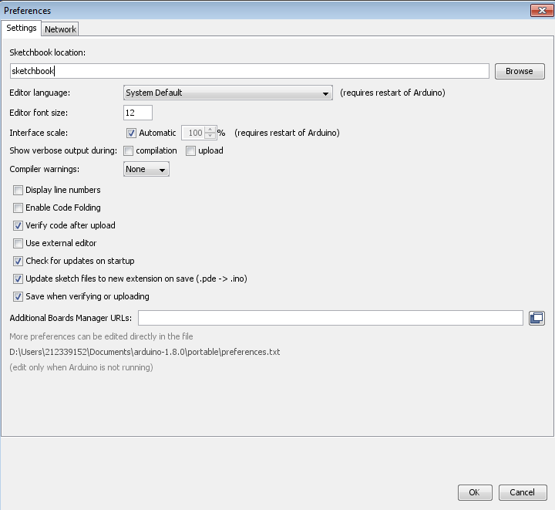
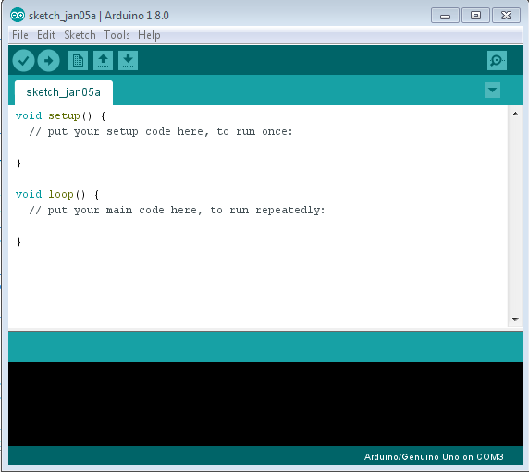
Step 4: Launch Arduino executable (this is the IDE)
Right-click to pin to Taskbar and Start Menu
Go to File - > Preferences and make sure that "Show verbose output during compilation" is unchecked and that “Compiler warnings” is set to none
Launched executable:
Click OK even if changes were not made. Then close IDE. Defaults are now set.

Slide 6


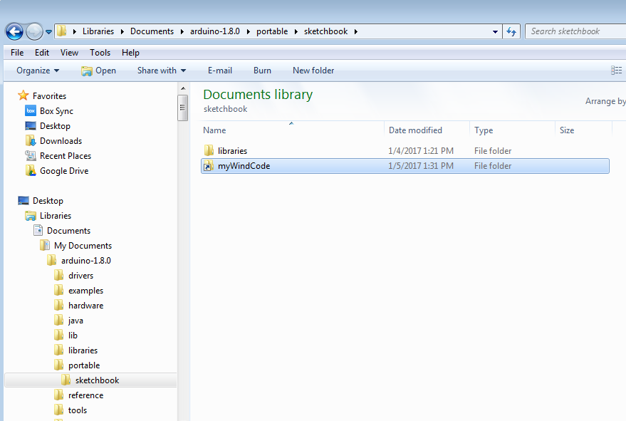
Step 5: Create symbolic link to source
Makes it easy to modify Arduino code
Browse to folder where you unzipped
Right-click “myWindCode” folder and select “Pick Link Source”
Browse back to root arduino-1.x.x folder -> portable -> sketchbook
Right-click and “Drop as… -> Symbolic Link”

Slide 7

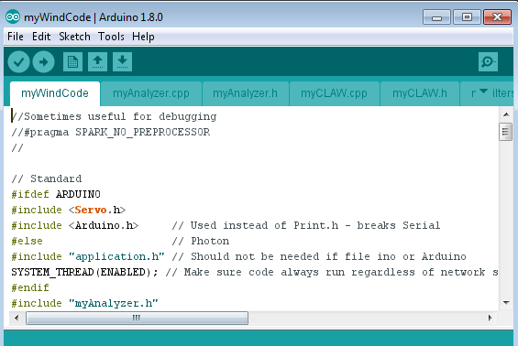
Step 6: Open file in IDE
1st : open IDE from Taskbar (or Start Menu)
2nd : go to file -> open -> browse to myWindCode.ino and open

Slide 8
Step 6: continued
Close all other IDE windows (except myWindCode) so IDE remembers your default choice.
Link to arduino reference: https://www.arduino.cc/en/Reference/HomePage
In brief: Ctrl-r to compile.
Try it now with myWindCode.
Ask for help if this does not work.
Ctrl-u to compile/upload.
Arduino needs to be connected and USB free
USB port selected by Tools – Port – select the one that says ‘Arduino.’ If there isn’t one, then it’s not connected to the computer. Perhaps the drivers did not load.

Slide 9
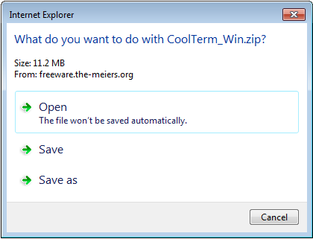
Step 7: Install CoolTerm USB
Link to install: http://freeware.the-meiers.org/CoolTerm_Win.zip
Unzip and copy “CoolTerm_0.stc” in this folder to the desktop for easy starting of USB

Slide 10
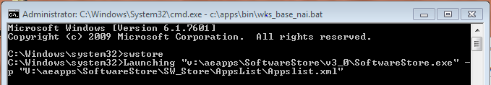
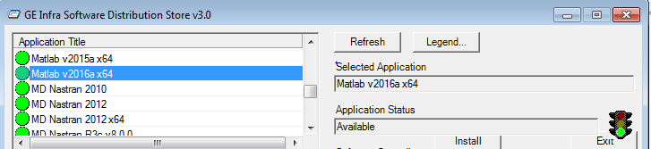
Last Step: Install Matlab R2016a
Must be a “Tech PC” or laptop not a business laptop
Start – cmd.exe – run as administrator
>swstore
Select

